Slide 1

Software
Metrics

Slide 2
Software Metrics
Software Metrics: What and Why ?
How to measure the size of a software?
How much will it cost to develop a software?
How many bugs can we expect?
When can we stop testing?
When can we release the software?

Slide 3
Software Metrics
What is the complexity of a module?
7. What is the module strength and coupling?
8. What is the reliability at the time of release?
9. Which test technique is more effective?
10. Are we testing hard or are we testing smart?
11. Do we have a strong program or a week test suite?

Slide 4
Software Metrics
Pressman explained as “A measure provides a quantitative indication of the extent, amount, dimension, capacity, or size of some attribute of the product or process”.
Measurement is the act of determine a measure
The metric is a quantitative measure of the degree to which a system, component, or process possesses a given attribute.
Fenton defined measurement as “ it is the process by which numbers or symbols are assigned to attributes of entities in the real world in such a way as to describe them according to clearly defined rules”.

Slide 5
Software Metrics
Definition
Software metrics can be defined as “The continuous application of measurement based techniques to the software development process and its products to supply meaningful and timely management information, together with the use of those techniques to improve that process and its products”.

Slide 6
Software Metrics
Areas of Applications
The most established area of software metrics is cost and size estimation techniques.
The prediction of quality levels for software, often in terms of reliability, is another area where software metrics have an important role to play.
The use of software metrics to provide quantitative checks on software design is also a well established area.

Slide 7
Software Metrics
Problems During Implementation
Statement : Software development is to complex; it cannot be managed like other parts of the organization.
Management view : Forget it, we will find developers and managers who will manage that development.
Statement : I am only six months late with project.
Management view : Fine, you are only out of a job.

Slide 8
Software Metrics
Statement : I am only six months late with project.
Management view : Fine, you are only out of a job.
Statement : But you cannot put reliability constraints in the contract.
Management view : Then we may not get the contract.

Slide 9
Software Metrics
Categories of Metrics
Product metrics: describe the characteristics of the product such as size, complexity, design features, performance, efficiency, reliability, portability, etc.
Process metrics: describe the effectiveness and quality of the processes that produce the software product. Examples are:
effort required in the process
time to produce the product
effectiveness of defect removal during development
number of defects found during testing
maturity of the process

Slide 10
Software Metrics
Project metrics: describe the project characteristics and execution. Examples are :
number of software developers
staffing pattern over the life cycle of the software
cost and schedule
productivity

Slide 11
Software Metrics
Token Count
The size of the vocabulary of a program, which consists of the number of unique tokens used to build a program is defined as:
    η = η₁+ η₂
    η : vocabulary of a program
    η₁ : number of unique operators
    η₂ : number of unique operands
where

Slide 12
Software Metrics
The length of the program in the terms of the total number of tokens used is
    N = N₁+N₂
    N : program length
    N₁ : total occurrences of operators
    N₂ : total occurrences of operands
where

Slide 13
Software Metrics
Volume
V = N * log₂ η
The unit of measurement of volume is the common unit for size “bits”. It is the actual size of a program if a uniform binary encoding for the vocabulary is used.
Program Level
L = V* / V
The value of L ranges between zero and one, with L=1 representing a program written at the highest possible level (i.e., with minimum size).

Slide 14
Software Metrics
Program Difficulty
D = 1 / L
As the volume of an implementation of a program increases, the program level decreases and the difficulty increases. Thus, programming practices such as redundant usage of operands, or the failure to use higher-level control constructs will tend to increase the volume as well as the difficulty.
Effort
E = V / L = D * V
The unit of measurement of E is elementary mental discriminations.

Slide 15
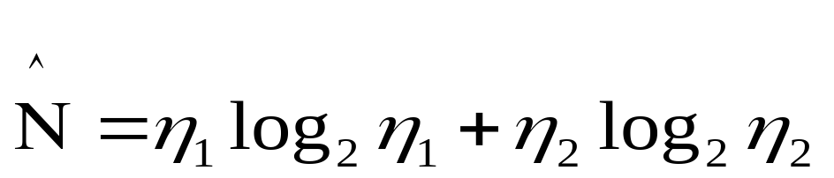
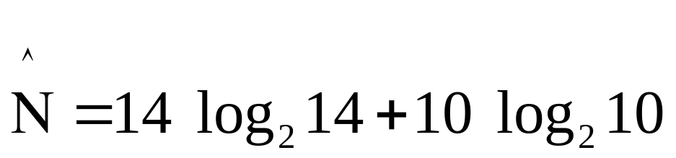
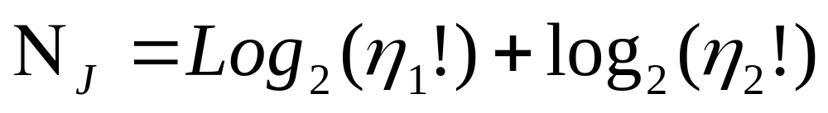
Software Metrics
Estimated Program Length
= 53.34 + 33.22 = 86.56
The following alternate expressions have been published to estimate program length.

Slide 16
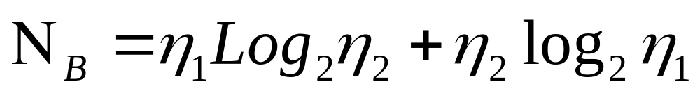
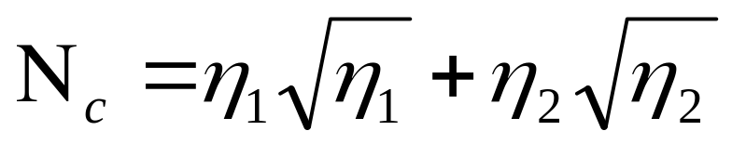

Software Metrics
The definitions of unique operators, unique operands, total operators and total operands are not specifically delineated.

Slide 17
Software Metrics
Counting rules for C language
Comments are not considered.
The identifier and function declarations are not considered.
All the variables and constants are considered operands.
Global variables used in different modules of the same program are counted as multiple occurrences of the same variable.

Slide 18
Software Metrics
Local variables with the same name in different functions are counted as unique operands.
Functions calls are considered as operators.
7. All looping statements e.g., do {…} while ( ), while ( ) {…}, for ( ) {…}, all control statements e.g., if ( ) {…}, if ( ) {…} else {…}, etc. are considered as operators.
8. In control construct switch ( ) {case:…}, switch as well as all the case statements are considered as operators.

Slide 19
Software Metrics
9. The reserve words like return, default, continue, break, sizeof, etc., are considered as operators.
10. All the brackets, commas, and terminators are considered as operators.
11. GOTO is counted as an operator and the label is counted as an operand.
12. The unary and binary occurrence of “+” and “-” are dealt separately. Similarly “*” (multiplication operator) are dealt with separately.

Slide 20
Software Metrics
13. In the array variables such as “array-name [index]” “array-name” and “index” are considered as operands and [ ] is considered as operator.
14. In the structure variables such as “struct-name, member-name” or “struct-name -> member-name”, struct-name, member-name are taken as operands and ‘.’, ‘->’ are taken as operators. Some names of member elements in different structure variables are counted as unique operands.
15. All the hash directive are ignored.

Slide 21
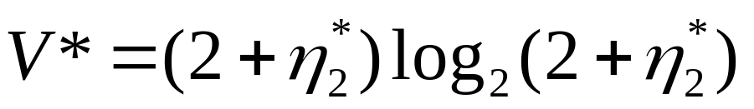
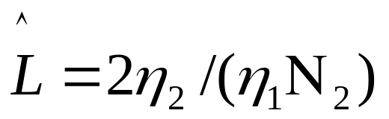
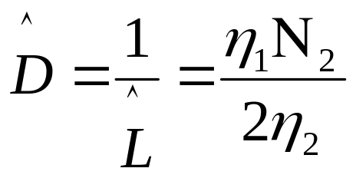
Software Metrics
Potential Volume
Estimated Program Level / Difficulty
Halstead offered an alternate formula that estimate the program level.
where

Slide 22
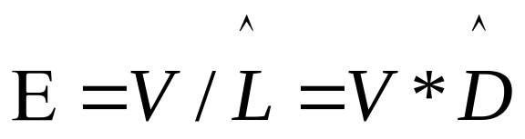
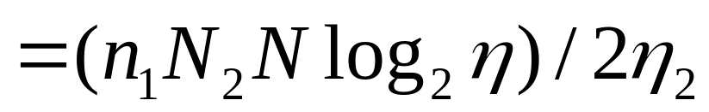
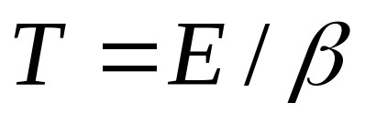
Software Metrics
Effort and Time
β is normally set to 18 since this seemed to give best results in Halstead’s earliest experiments, which compared the predicted times with observed programming times, including the time for design, coding, and testing.

Slide 23
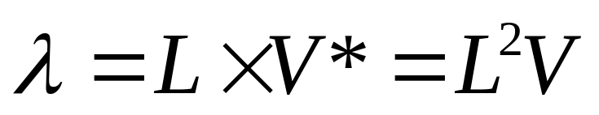
Software Metrics
Language Level
Using this formula, Halstead and other researchers determined the language level for various languages as shown in Table 1.

Slide 24
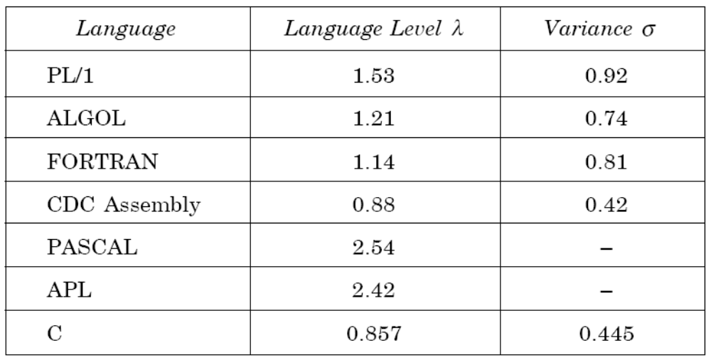
Software Metrics
Table 1: Language levels

Slide 25

Software Metrics
Example- 6.I
Consider the sorting program in Fig. 2 of chapter 4. List out the operators and operands and also calculate the values of software science measures like

Slide 26
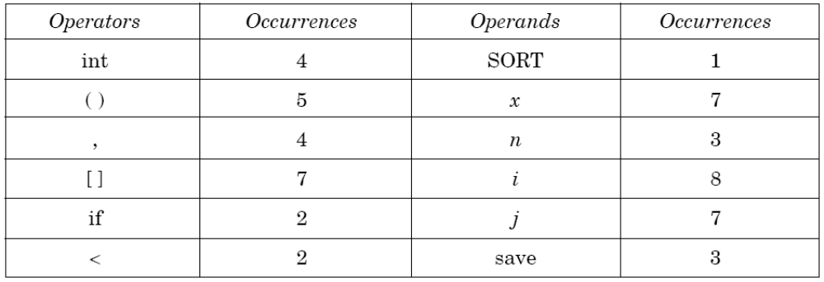

Software Metrics
Solution
The list of operators and operands is given in table 2.

Slide 27
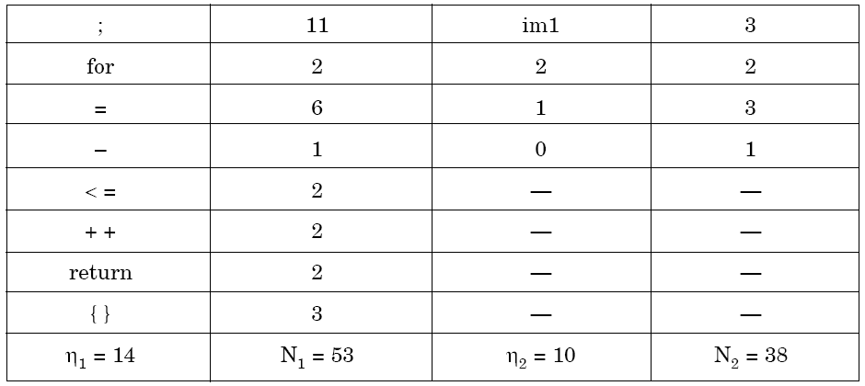
Software Metrics
Table 2: Operators and operands of sorting program of fig. 2 of chapter 4

Slide 28
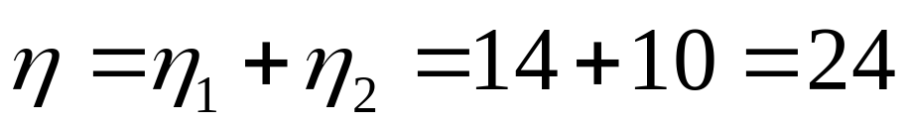
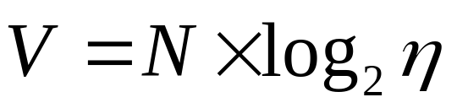

Software Metrics
Here N₁=53 and N₂=38. The program length N=N₁+N₂=91
Vocabulary of the program
Volume
= 91 x log₂24 = 417 bits
The estimated program length of the program
= 14 log₂14 + 10 log₂10
= 14 * 3.81 + 10 * 3.32
= 53.34 + 33.2 = 86.45

Slide 29
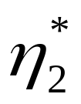
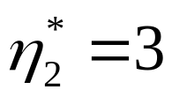
Software Metrics
Conceptually unique input and output parameters are represented by
{x: array holding the integer to be sorted. This is used both as input and output}.
{N: the size of the array to be sorted}.
The potential volume V* = 5 log₂5 = 11.6
Since
L = V* / V

Slide 30
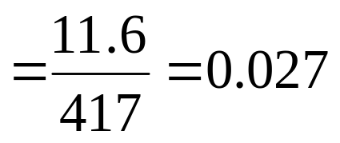
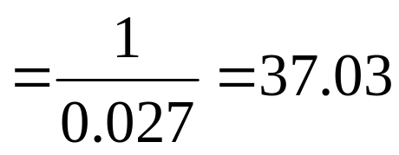
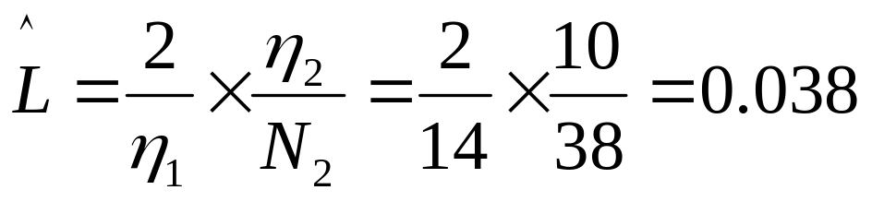
Software Metrics
D = I / L
Estimated program level

Slide 31
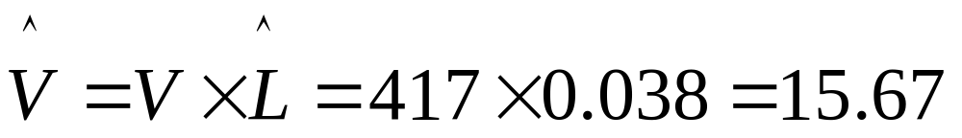
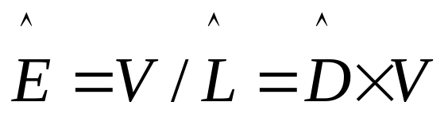
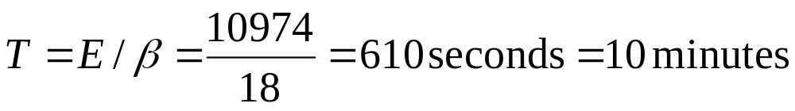
Software Metrics
We may use another formula
=417 / 0.038 = 10973.68
Therefore, 10974 elementary mental discrimination are required to construct the program.
This is probably a reasonable time to produce the program, which is very simple

Slide 32
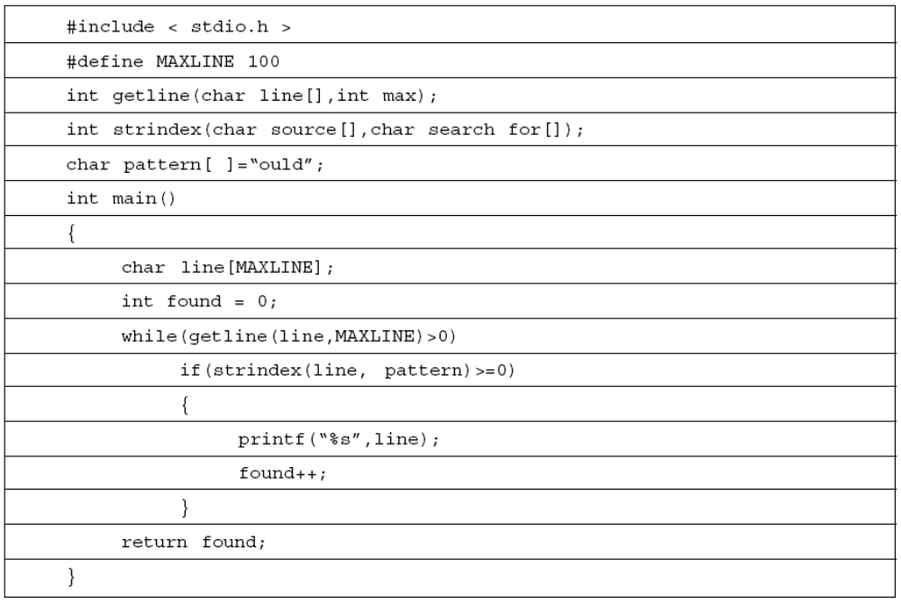
Software Metrics
Table 3

Slide 33
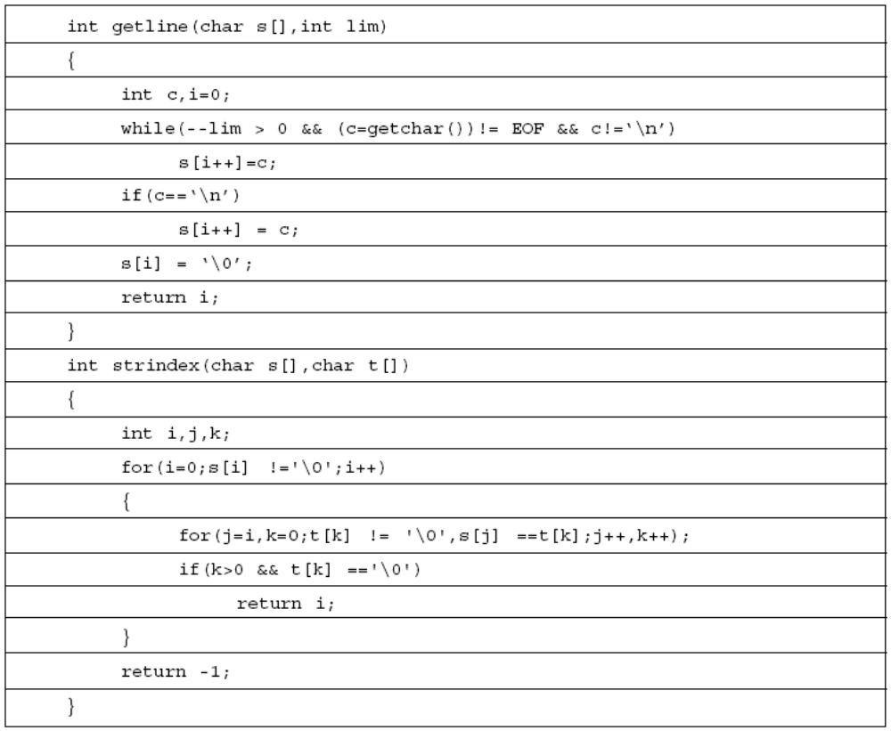
Software Metrics
Table 3

Slide 34
Software Metrics
Example- 6.2
Consider the program shown in Table 3. Calculate the various software science metrics.

Slide 35
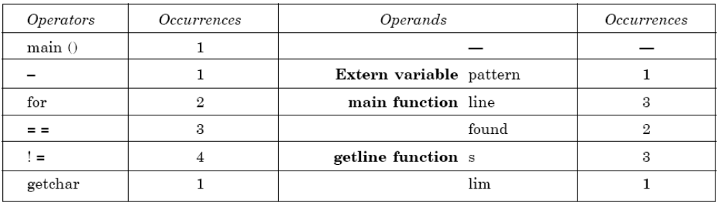
Software Metrics
Solution
List of operators and operands are given in Table 4.
Table 4

Slide 36
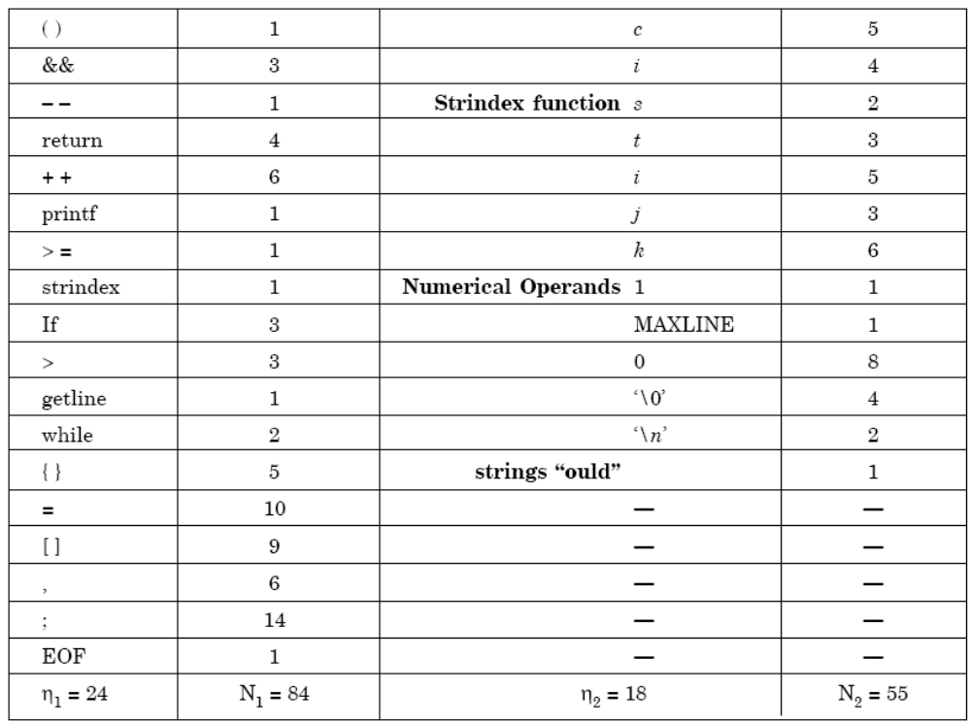
Software Metrics
Table 5

Slide 37
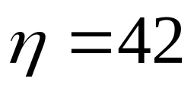
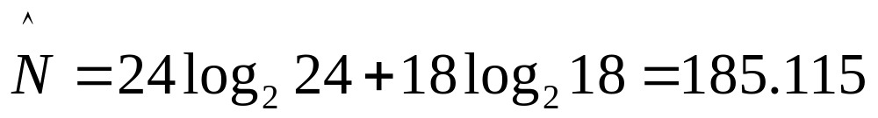
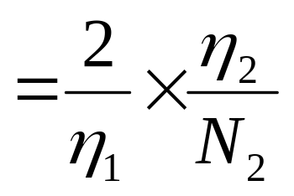
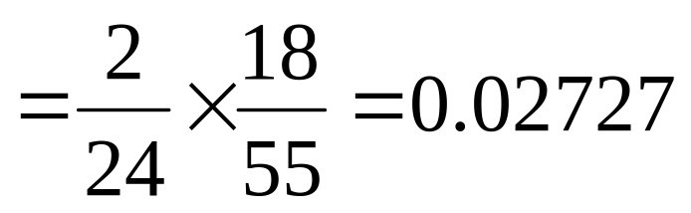
Software Metrics
Program vocabulary
Program length
N = N₁ +N₂
= 84 + 55 = 139
Estimated length
% error = 24.91
Program volume V = 749.605 bits
Estimated program level

Slide 38
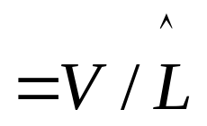
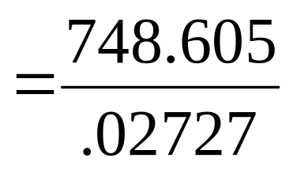
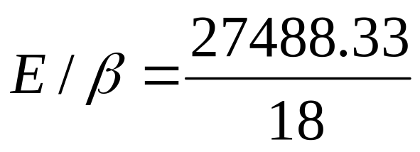
Software Metrics
Minimal volume
V*=20.4417
Effort
= 27488.33 elementary mental discriminations.
Time T =
= 1527.1295 seconds
= 25.452 minutes

Slide 39
Software Metrics
Data Structure Metrics
Program | Data Input | Internal Data | Data Output
Payroll
Name/ Social Security No./ Pay Rate/ Number of hours worked
Withholding rates
Overtime factors
Insurance premium
Rates
Gross pay withholding
Net pay
Pay ledgers
Spreadsheet
Item Names/ Item amounts/ Relationships among items
Cell computations
Sub-totals
Spreadsheet of items and totals
Software Planner
Program size/ No. of software developers on team
Model parameters
Constants
Coefficients
Est. project effort
Est. project duration
Fig.1: Some examples of input, internal, and output data

Slide 40
Software Metrics
The Amount of Data
One method for determining the amount of data is to count the number of entries in the cross-reference list.
A variable is a string of alphanumeric characters that is defined by a developer and that is used to represent some value during either compilation or execution.

Slide 41
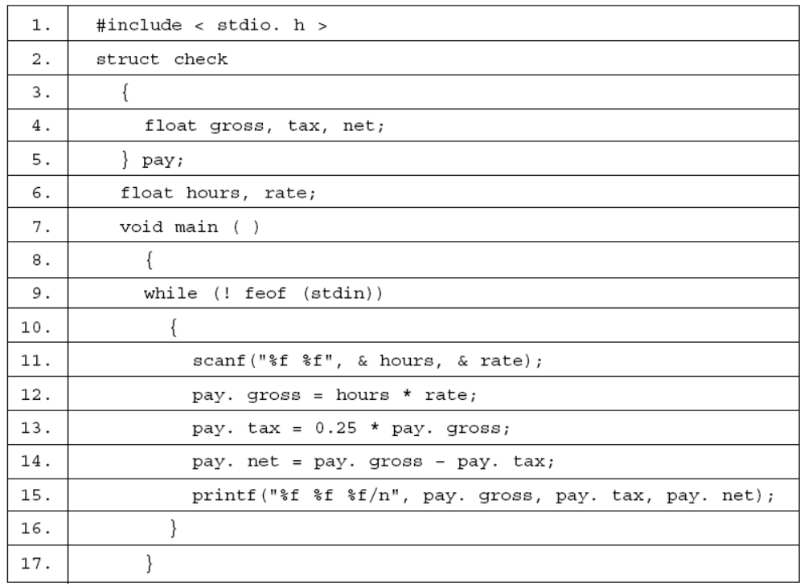
Software Metrics
Fig.2: Payday program

Slide 42
Software Metrics
check
2
gross
4
12
13
14
15
hours
6
11
12
net
4
14
15
pay
5
12
13
13
14
14
14
15
15
15
rate
6
11
12
tax
4
13
14
15
Fig.3: A cross reference of program payday

Slide 43
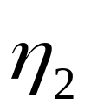
Software Metrics
feof | 9
stdin | 10
Fig.4: Some items not counted as VARS
= VARS + unique constants + labels.
Halstead introduced a metric that he referred to as to be a count of the operands in a program – including all variables, constants, and labels. Thus,

Slide 44
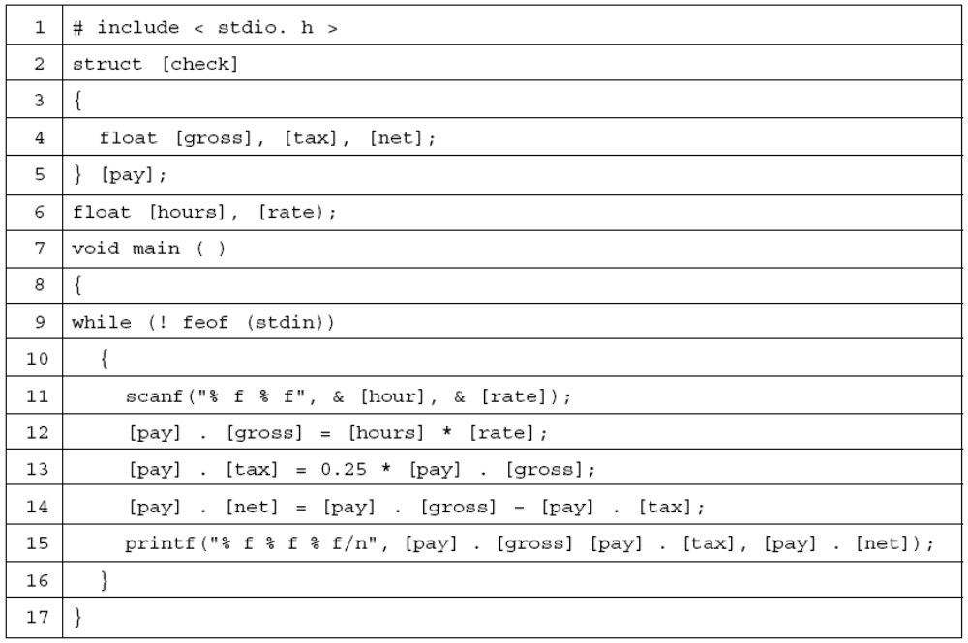
Software Metrics
Fig.6: Program payday with operands in brackets

Slide 45
Software Metrics
The Usage of Data within a Module
Live Variables
Definitions :
A variable is live from the beginning of a procedure to the end of the procedure.
A variable is live at a particular statement only if it is referenced a certain number of statements before or after that statement.
A variable is live from its first to its last references within a procedure.

Slide 46
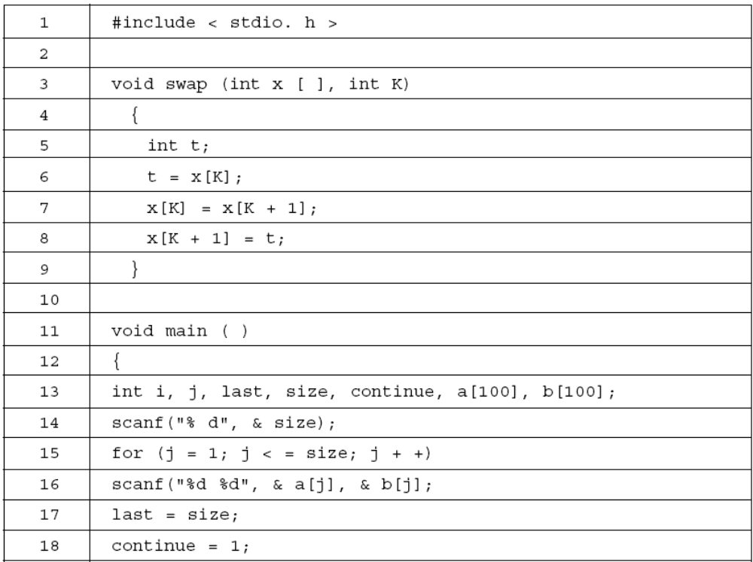
Software Metrics
cont…

Slide 47
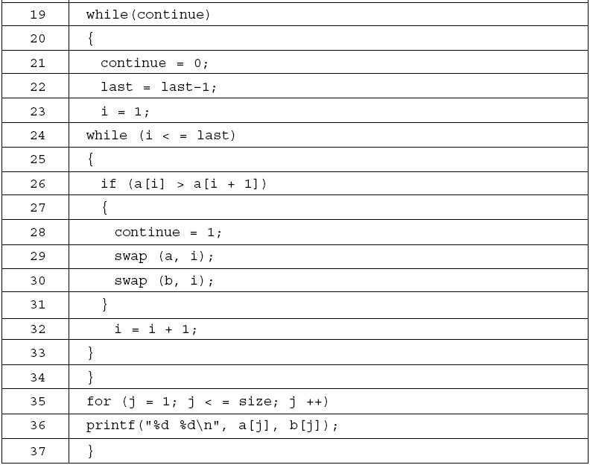
Software Metrics
Fig.6: Bubble sort program

Slide 48
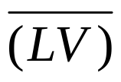
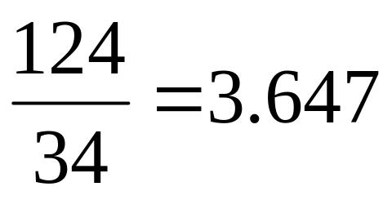
Software Metrics
It is thus possible to define the average number of live variables,
which is the sum of the count of live variables divided by the count of executable statements in a procedure. This is a complexity measure for data usage in a procedure or program. The live variables in the program in fig. 6 appear in fig. 7 the average live variables for this program is

Slide 49
Software Metrics
Line | Live Variables | Count
4
----
0
5
----
0
6
t, x, k
3
7
t, x, k
3
8
t, x, k
3
9
----
0
10
----
0
11
----
0
12
----
0
13
----
0
14
size
1
15
size, j
2
16
Size, j, a, b
4
cont…

Slide 50
Software Metrics
Line | Live Variables | Count
17
size, j, a, b, last
5
18
size, j, a, b, last, continue
6
19
size, j, a, b, last, continue
6
20
size, j, a, b, last, continue
6
21
size, j, a, b, last, continue
6
22
size, j, a, b, last, continue
6
23
size, j, a, b, last, continue, i
7
24
size, j, a, b, last, continue, i
7
25
size, j, a, b, continue, i
6
26
size, j, a, b, continue, i
6
27
size, j, a, b, continue, i
6
28
size, j, a, b, continue, i
6
29
size, j, a, b, i
5
cont…

Slide 51
Software Metrics
Line | Live Variables | Count
30
size, j, a, b, i
5
31
size, j, a, b, i
5
32
size, j, a, b, i
5
33
size, j, a, b
4
34
size, j, a, b
4
35
size, j, a, b
4
36
j, a, b
3
37
--
0
Fig.7: Live variables for the program in fig.6

Slide 52
Software Metrics
Variable spans
… 21 … 32 … 45 … 53 … 60 … | scanf (“%d %d, &a, &b) x =a; y = a – b; z = a; printf (“%d %d, a, b);
Fig.: Statements in ac program referring to variables a and b.
The size of a span indicates the number of statements that pass between successive uses of a variables

Slide 53
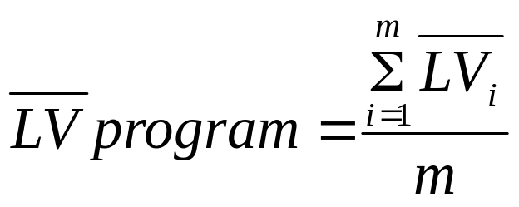


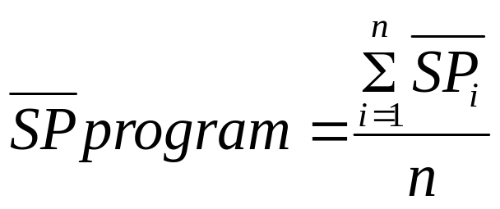
Software Metrics
Making program-wide metrics from intra-module metrics
For example if we want to characterize the average number of live variables for a program having modules, we can use this equation.
where is the average live variable metric computed from the ith module
The average span size for a program of n spans could be computed by using the equation.

Slide 54



Software Metrics
Program Weakness
A program consists of modules. Using the average number of live variables and average life variables , the module weakness has been defined as

Slide 55
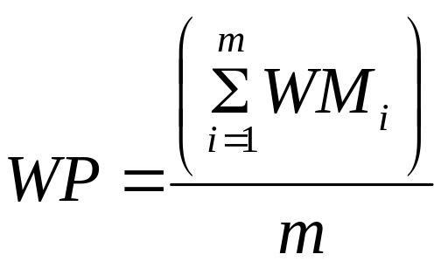
Software Metrics
A program is normally a combination of various modules, hence program weakness can be a useful measure and is defined as:
where, WM_{i} : weakness of ith module
WP : weakness of the program
m : number of modules in the program

Slide 56


Software Metrics
Example- 6.3
Consider a program for sorting and searching. The program sorts an array using selection sort and than search for an element in the sorted array. The program is given in fig. 8. Generate cross reference list for the program and also calculate and WM for the program.

Slide 57
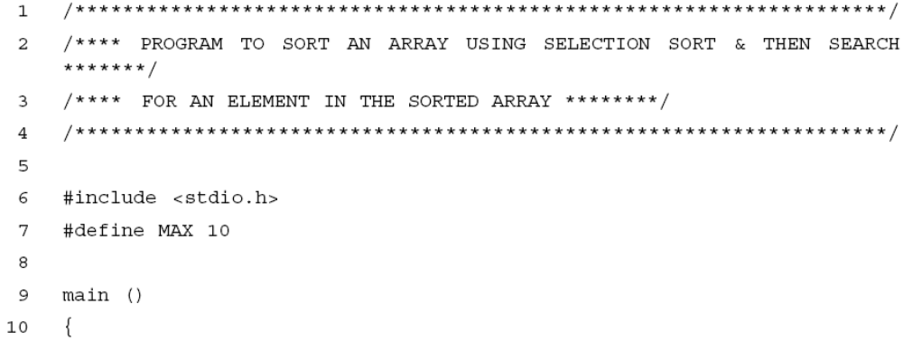
Software Metrics
Solution
The given program is of 66 lines and has 11 variables. The variables are a, I, j, item, min, temp, low, high, mid, loc and option.

Slide 58
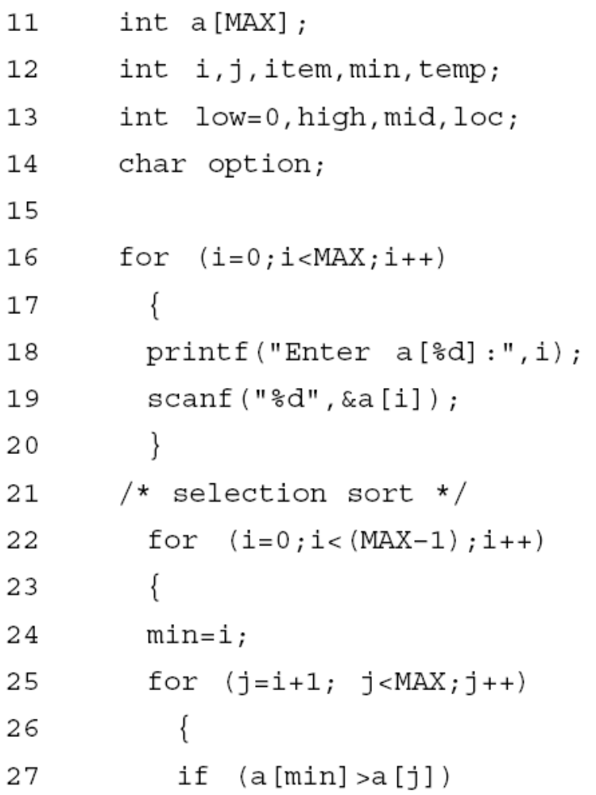
Software Metrics

Slide 59
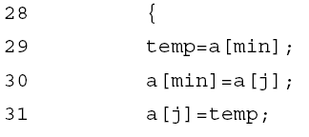
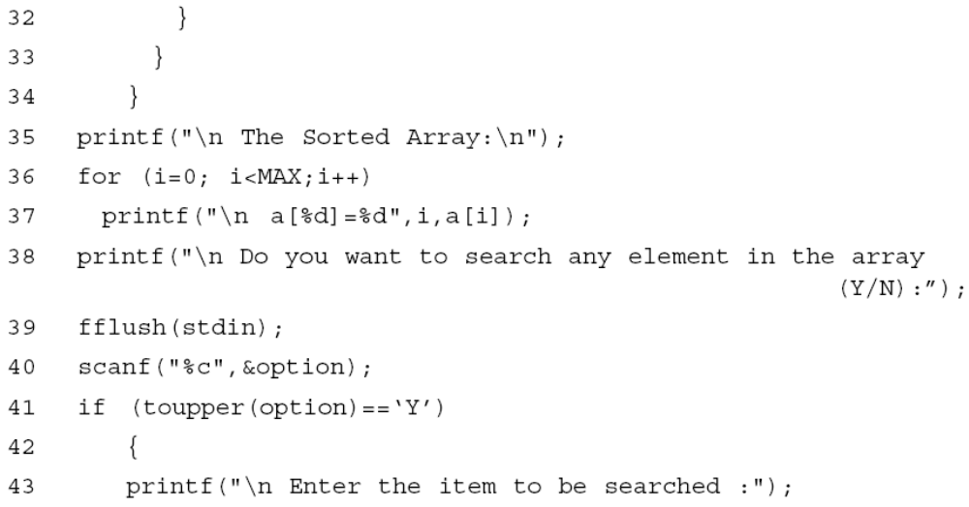
Software Metrics

Slide 60

Software Metrics

Slide 61

Software Metrics
Fig.8: Sorting & searching program

Slide 62
Software Metrics
Cross-Reference list of the program is given below:
a
11
18
19
27
27
29
30
30
31
37
47
49
59
i
12
16
16
16
18
19
22
22
22
24
36
36
36
37
37
j
12
25
25
25
27
30
31
item
12
44
47
49
59
62
min
12
24
27
29
30
temp
12
29
31
low
13
46
47
50
52
54
high
13
45
46
47
51
52
54
mid
13
46
47
49
50
51
52
59
61
loc
13
56
61
62
option
14
40
41

Slide 63
Live Variables per line are calculated as:
Line | Live Variables | Count
13
low
1
14
low
1
15
low
1
16
low, i
2
17
low, i
2
18
low, i, a
3
19
low, i, a
3
20
low, i, a
3
22
low, i, a
3
23
low, i, a
3
24
low, i, a, min
4
25
low, i, a, min, j
5
26
low, i, a, min, j
5
cont…

Slide 64
Software Metrics
Line | Live Variables | Count
27
low, i, a, min, j
5
28
low, i, a, min, j
5
29
low, i, a, min, j, temp
6
30
low, i, a, min, j, temp
6
31
low, i, a, j, temp
5
32
low, i, a
3
33
low, i, a
3
34
low, i, a
3
35
low, i, a
3
36
low, i, a
3
37
low, i, a
3
38
low, a
2
39
low, a
2
cont…

Slide 65
Software Metrics
Line | Live Variables | Count
40
low, a, option
3
41
low, a, option
3
42
low, a
2
43
low, a
2
44
low, a, item
3
45
low, a, item, high
4
46
low, a, item, high, mid
5
47
low, a, item, high, mid
5
48
low, a, item, high, mid
5
49
low, a, item, high, mid
5
50
low, a, item, high, mid
5
51
low, a, item, high, mid
5
52
low, a, item, high, mid
5
cont…

Slide 66
Software Metrics
Line | Live Variables | Count
53
low, a, item, high, mid
5
54
low, a, item, high, mid
5
55
a, item, mid
3
56
a, item, mid, loc
4
57
a, item, mid, loc
4
58
a, item, mid, loc
4
59
a, item, mid, loc
4
60
item, mid, loc
3
61
item, mid, loc
3
62
item, loc
2
cont…

Slide 67
Software Metrics
Line | Live Variables | Count
63
0
64
0
65
0
66
0
Total
174

Slide 68



Software Metrics
Average number of live variables ( ) =

Slide 69

Software Metrics
The Sharing of Data Among Modules
A program normally contains several modules and share coupling among modules. However, it may be desirable to know the amount of data being shared among the modules.
Fig.10: Three modules from an imaginary program

Slide 70


Software Metrics
Fig.11: ”Pipes” of data shared among the modules
Fig.12: The data shared in program bubble

Slide 71
Software Metrics
Information Flow Metrics
Component : Any element identified by decomposing a (software) system into its constituent parts.
Cohesion : The degree to which a component
performs a single function.
Coupling : The term used to describe the degree of linkage between one component to others in the same system.

Slide 72
Software Metrics
The Basic Information Flow Model
Information Flow metrics are applied to the Components of a system design. Fig. 13 shows a fragment of such a design, and for component ‘A’ we can define three measures, but remember that these are the simplest models of IF.
‘FAN IN’ is simply a count of the number of other Components that can call, or pass control, to Component A.
‘FANOUT’ is the number of Components that are called by Component A.
This is derived from the first two by using the following formula. We will call this measure the INFORMATION FLOW index of Component A, abbreviated as IF(A).
IF(A) = [FAN IN(A) x FAN OUT (A)]²

Slide 73

Software Metrics
Fig.13: Aspects of complexity

Slide 74
Software Metrics
The following is a step-by-step guide to deriving these most simple of IF metrics.
Note the level of each Component in the system design.
For each Component, count the number of calls so that Component – this is the FAN IN of that Component. Some organizations allow more than one Component at the highest level in the design, so for Components at the highest level which should have a FAN IN of zero, assign a FAN IN of one. Also note that a simple model of FAN IN can penalize reused Components.
For each Component, count the number of calls from the Component. For Component that call no other, assign a FAN OUT value of one.
cont…

Slide 75
Software Metrics
Calculate the IF value for each Component using the above formula.
Sum the IF value for all Components within each level which is called as the LEVEL SUM.
Sum the IF values for the total system design which is called the SYSTEM SUM.
7. For each level, rank the Component in that level according to FAN IN, FAN OUT and IF values. Three histograms or line plots should be prepared for each level.
8. Plot the LEVEL SUM values for each level using a histogram or line plot.

Slide 76
Software Metrics
A More Sophisticated Information Flow Model
a = the number of components that call A.
b = the number of parameters passed to A from components higher in the hierarchy.
c = the number of parameters passed to A from components lower in the hierarchy.
d = the number of data elements read by component A.
Then:
FAN IN(A)= a + b + c + d

Slide 77
Software Metrics
Also let:
e = the number of components called by A;
f = the number of parameters passed from A to components higher in the hierarchy;
g = the number of parameters passed from A to components lower in the hierarchy;
h = the number of data elements written to by A.
Then:
FAN OUT(A)= e + f + g + h

Slide 78
Object Oriented Metrics
Terminologies
S.No | Term | Meaning/purpose
1 | Object | Object is an entity able to save a state (information) and offers a number of operations (behavior) to either examine or affect this state.
2 | Message | A request that an object makes of another object to perform an operation.
3 | Class | A set of objects that share a common structure and common behavior manifested by a set of methods; the set serves as a template from which object can be created.
4 | Method | an operation upon an object, defined as part of the declaration of a class.
5 | Attribute | Defines the structural properties of a class and unique within a class.
6 | Operation | An action performed by or on an object, available to all instances of class, need not be unique.

Slide 79
Object Oriented Metrics
Terminologies
S.No | Term | Meaning/purpose
7 | Instantiation | The process of creating an instance of the object and binding or adding the specific data.
8 | Inheritance | A relationship among classes, where in an object in a class acquires characteristics from one or more other classes.
9 | Cohesion | The degree to which the methods within a class are related to one another.
10 | Coupling | Object A is coupled to object B, if and only if A sends a message to B.

Slide 80
Object Oriented Metrics
Measuring on class level
  coupling
  inheritance
  methods
  attributes
  cohesion
Measuring on system level

Slide 81
Object Oriented Metrics
Size Metrics:
Number of Methods per Class (NOM)
Number of Attributes per Class (NOA)
Weighted Number Methods in a Class (WMC)
  Methods implemented within a class or the sum of the complexities of all methods

Slide 82
Object Oriented Metrics
Coupling Metrics:
Response for a Class (RFC )
  Number of methods (internal and external) in a class.
Data Abstraction Coupling(DAC)
  Number of Abstract Data Types in a class.
Coupling between Objects (CBO)
  Number of other classes to which it is coupled.

Slide 83
Object Oriented Metrics
Message Passing Coupling (MPC)
  Number of send statements defined in a class.
Coupling Factor (CF)
  Ratio of actual number of coupling in the system to the max. possible coupling.

Slide 84


Object Oriented Metrics
Cohesion Metrics:
LCOM: Lack of cohesion in methods
  Consider a class C₁ with n methods M₁, M₂…., M_{n}. Let (I_{j}) = set of all instance variables used by method M_{i}. There are n such sets {I₁},…….{I_{n}}. Let
If all n
  sets are 0 then P=0

Slide 85
Object Oriented Metrics
Tight Class Cohesion (TCC)
  _ Percentage of pairs of public methods of the class with common attribute usage.
Loose Class Cohesion (LCC)
  Same as TCC except that this metric also consider indirectly connected methods.
Information based Cohesion (ICH)
  Number of invocations of other methods of the same class, weighted by the number of parameters of the invoked method.

Slide 86
Object Oriented Metrics
Inheritance Metrics:
DIT - Depth of inheritance tree
NOC - Number of children
  only immediate subclasses are counted.

Slide 87


Object Oriented Metrics
Inheritance Metrics:
AIF- Attribute Inheritance Factor
  Ratio of the sum of inherited attributes in all classes of the system to the total number of attributes for all classes.
TC= total number of classes
Ad (Ci) = number of attribute declared in a class
Ai (Ci) = number of attribute inherited in a class

Slide 88


Object Oriented Metrics
Inheritance Metrics:
MIF- Method Inheritance Factor
  Ratio of the sum of inherited methods in all classes of the system to the total number of methods for all classes.
TC= total number of classes
Md(Ci)= the number of methods declared in a class
Mi(Ci)= the number of methods inherited in a class

Slide 89
Use-Case Oriented Metrics
Counting actors
Type | Description | Factor
Simple | Program interface | 1
Average | Interactive or protocol driven interface | 2
Complex | Graphical interface | 3
Actor weighting factors
Simple actor: represents another system with a defined interface.
Average actor: another system that interacts through a text based interface through a protocol such as TCP/IP.
Complex actor: person interacting through a GUI interface.
The actors weight can be calculated by adding these values together.

Slide 90
Use-Case Oriented Metrics
Counting use cases
Type | Description | Factor
Simple | 3 or fewer transactions | 5
Average | 4 to 7 transactions | 10
Complex | More than 7 transactions | 15
Transaction-based weighting factors
The number of each use case type is counted in the software and then each number is multiplied by a weighting factor as shown in table above.

Slide 91
Web Engineering Project Metrics
Number of static web pages
Number of dynamic web pages
Number of internal page links
Word count
Web page similarity
Web page search and retrieval
Number of static content objects
Number of dynamic content objects

Slide 92
Metrics Analysis
Statistical Techniques
Summary statistics such as mean, median, max. and min.
Graphical representations such as histograms, pie charts and box plots.
Principal component analysis
Regression and correlation analysis
Reliability models for predicting future reliability.

Slide 93
Metrics Analysis
Problems with metric data:
Normal Distribution
Outliers
Measurement Scale
Multicollinearity

Slide 94
Metrics Analysis
Common pool of data:
The selection of projects should be representative and not all come from a single application domain or development styles.
No single very large project should be allowed to dominate the pool.
For some projects, certain metrics may not have been collected.

Slide 95
Metrics Analysis
Pattern of Successful Applications:
Any metric is better then none.
Automation is essential.
Empiricism is better then theory.
Use multifactor rather then single metrics.
Don’t confuse productivity metrics with complexity metrics.
Let them mature.
Maintain them.
Let them die.

Slide 96




Multiple Choice Questions
Note: Choose most appropriate answer of the following questions:
6.1 Which one is not a category of software metrics ?
(a) Product metrics (b) Process metrics
(c) Project metrics (d) People metrics
6.2 Software science measures are developed by
(a) M.Halstead (b) B.Littlewood
(c) T.J.McCabe (d) G.Rothermal
6.3 Vocabulary of a program is defined as:
6.4 In halstead theory of software science, volume is measured in bits. The bits are
(a) Number of bits required to store the program
(b) Actual size of a program if a uniform binary encoding scheme for vocabulary is used
(c) Number of bits required to execute the program
(d) None of the above

Slide 97







Multiple Choice Questions
6.5 In Halstead theory, effort is measured in
(a) Person-months (b) Hours
(c) Elementary mental discriminations (d) None of the above
6.6 Language level is defined as
6.7 Program weakness is
(d) None of the above
6.8 ‘FAN IN’ of a component A is defined as
(a) Count of the number of components that can call, or pass control, to component A
(b) Number of components related to component A
(c) Number of components dependent on component A
(d) None of the above

Slide 98
Multiple Choice Questions
6.9 ‘FAN OUT’ of a component A is defined as
(a) number of components related to component A
(b) number of components dependent on component A
(c) number of components that are called by component A
(d) none of the above
6.10 Which is not a size metric?
(a) LOC (b) Function count
(c) Program length (d) Cyclomatic complexity
6.11 Which one is not a measure of software science theory?
(a) Vocabulary (b) Volume
(c) Level (d) Logic
6.12 A human mind is capable of making how many number of elementary mental discriminations per second (i.e., stroud number)?
(a) 5 to 20 (b) 20 to 40
(c) 1 to 10 (d) 40 to 80

Slide 99
Multiple Choice Questions
6.13 Minimal implementation of any algorithm was given the following name by Halstead:
(a) Volume (b) Potential volume
(c) Effective volume (d) None of the above
6.14 Program volume of a software product is
(a) V=N log₂n (b) V=(N/2) log₂n
(c) V=2N log₂n (d) V=N log₂n+1
6.15 Which one is the international standard for size measure?
(a) LOC (b) Function count
(c) Program length (d) None of the above
6.16 Which one is not an object oriented metric?
(a) RFC (b) CBO
(c)DAC (d) OBC

Slide 100
Multiple Choice Questions
6.17 Which metric also consider indirect connected methods?
(a) TCC (b) LCC
(c) Both of the above (d) None of the above
6.18 depth of inheritance tree (DIT) can be measured by:
(a) Number of ancestors classes (b) Number of successor classes
(c) Number of failure classes (d) Number of root classes
6.19 A dynamic page is:
(a) where contents are not dependent on the actions of the user
(b) where contents are dependent on the actions of the user
(c) where contents cannot be displayed
(d) None of the above
6.20 Which of the following is not a size metric?
(a) LOC (b) FP
(c) Cyclomatic Complexity (d) program length

Slide 101
Exercises
6.1 Define software metrics. Why do we really need metrics in software?
6.2 Discus the areas of applications of software metrics? What are the problems during implementation of metrics in any organizations?
6.3 What are the various categories of software metrics? Discuss with the help of suitable example.
6.4 Explain the Halstead theory of software science. Is it significant in today’s scenario of component based software development?
6.5 What is the importance of language level in Halstead theory of software science?
6.6 Give Halstead’s software science measure for:
(i) Program Length (ii) Program volume
(iii) Program level (iv) Effort
(v) Language level

Slide 102


Exercises
6.7 For a program with number of unique operators and number of unique operands , Compute the following:
(i) Program volume (ii) Effort and time
(iii) Program length (iv) Program level
6.8 Develop a small software tool that will perform a Halstead analysis on a programming language source code of your choice.
6.9 Write a program in C and also PASCAL for the calculation of the roots of a quadratic equation, Find out all software science metrics for both the programs. Compare the outcomes and comment on the efficiency and size of both the source codes.
6.10 How should a procedure identifier be considered, both when declared and when called/ What about the identifier of a procedure that is passed as a parameter to another procedure?

Slide 103
Exercises
6.11 Assume that the previous payroll program is expected to read a file containing information about all the cheques that have been printed. The file is supposed to be printed and also used by the program next time it is run, to produce a report that compares payroll expenses of the current month with those of the previous month. Compute functions points for this program. Justify the difference between the function points of this program and previous one by considering how the complexity of the program is affected by adding the requirement of interfacing with another application (in this case, itself).
6.12 Define data structure metrics. How can we calculate amount of data in a program?
6.13 Describe the concept of module weakness. Is it applicable to programs also.
6.14 Write a program for the calculation of roots of a quadratic equation. Generate cross reference list for the program and also calculate for this program.

Slide 104
Exercises
6.15 Show that the value of SP at a particular statement is also the value of LV at that point.
6.16 Discuss the significance of data structure metrics during testing.
6.17 What are information flow metrics? Explain the basic information flow model.
6.18 Discuss the problems with metrics data. Explain two methods for the analysis of such data.
6.19 Show why and how software metrics can improve the software process. Enumerate the effect of metrics on software productivity.
6.20 Why does lines of code (LOC) not measure software nesting and control structures?
6.21 Several researchers in software metrics concentrate on data structure to measure complexity. Is data structure a complexity or quality issue, or both?

Slide 105
Exercises
6.22 List the benefits and disadvantages of using Library routines rather than writing own code.
6.23 Compare software science measure and function points as measure of complexity. Which do you think more useful as a predictor of how much particular software’s development will cost?
6.24 Some experimental evidence suggests that the initial size estimate for a project affects the nature and results of the project. Consider two different managers charged with developing the same application. One estimates that the size of the application will be 50,000 lines, while the other estimates that it will be 100,000 lines. Discuss how these estimates affect the project throughout its life cycle.
6.25 Which one is the most appropriate size estimation technique and why?
6.26 Discuss the object oriented metrics. What is the importance of metrics in object oriented software development ?

Slide 106
Exercises
6.27 Define the following: RFC, CBO, DAC, TCC, LCC & DIT.
6.28 What is the significance of use case metrics? Is it really important to design such metrics?

